Slide 1



Long Travel Bus Reservation
Group member
Nguyễn Sơn Trường
Nguyễn Lương Hải
Nguyễn Thị Bích Trâm
Nguyễn Ngọc Sơn
Supervisor
Kiều Trọng Khánh

Slide 2

Contents
Problem
Solution
Terms
Main Functions
Technologies
Summary
Demo
Q&A

Slide 3
Problem
Average number of departures in a day in Mien Dong Bus Station ^{(*)}
*statistic in 2010 from http://www.benxemiendong.com.vn/

Slide 4


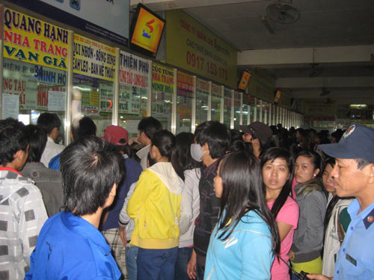
Problem
OVERLOADED!
Customer
Staff
Managing
Scheduling
Selling tickets
Waiting for hours to buy tickets

Slide 5



Solution
Managing bus
Managing route
Managing fares
Scheduling
Booking tickets
Online payments
Long Travel Bus Reservation
Consult transaction history

Slide 6
Terms
Hà Nội
Route and segments
Hồ Chí Minh City
Đà Nẵng
Segment
Hải Phòng
Route
Route: Hồ Chí Minh City – Hải Phòng contains 2 segments:
Hồ Chí Minh City – Đà Nẵng,
Đà Nẵng – Hải Phòng
Route: Hồ Chí Minh City – Hà Nội contains 2 segments:
Hồ Chí Minh City – Đà Nẵng,
Đà Nẵng – Hà Nội

Slide 7
Terms
Tariff
Hồ Chí Minh City
Đà Nẵng
200,000 VND
Hải Phòng
Segment | Valid date | Fare
Hồ Chí Minh City – Đà Nẵng | 30/04/2013 | 200,000 VNĐ
Hồ Chí Minh City – Đà Nẵng | 01/06/2013 | 250,000 VNĐ
From 0:00 30/04/2013 – 23:59 31/05/2013: 200,000 VNĐ
From 0:00 01/06/2013 – future: 250,000 VNĐ

Slide 8

Terms
Schedule and trip
Hồ Chí Minh City
Đà Nẵng
10:30 1/5/2013
03:30 2/5/2013
Hải Phòng
20:30 2/5/2013
Schedule
Bus A is scheduled to run on route Hồ Chí Minh City – Hải Phòng from 10:30 1/5/2013 to 20:30 2/5/2013
Trip
There are 2 trips in the schedule
Hồ Chí Minh City (10:30 1/5/2013) – Đà Nẵng (3:30 2/5/2013)
Đà Nẵng (3:30 2/5/2013) – Hải Phòng (20:30 2/5/2013)

Slide 9

Terms
Ticket and journey
Hồ Chí Minh City
Đà Nẵng
10:30 1/5/2013
03:30 2/5/2013
Hải Phòng
20:30 2/5/2013
Ticket
Customer 1 books for a ticket from Hồ Chí Minh City to Hải Phòng (ticket has 2 trips)
Customer 2 books for a ticket from Đà Nẵng to Hải Phòng (ticket has 1 trip)
Journey
Hồ Chí Minh City – Đà Nẵng – Hải Phòng
Đà Nẵng – Hải Phòng

Slide 10


Terms
Reservation
Hồ Chí Minh City
Đà Nẵng
Hải Phòng
Reservation
Customer 1 books for a ticket from Hồ Chí Minh City to Hải Phòng. Reservation of customer 1 has only one ticket
Customer 2 books for round-trip from Hồ Chí Minh City to Hải Phòng and Hải Phòng return to Hồ Chí Minh City. Reservation of customer 2 has two tickets.

Slide 11


Main functions
Managing bus
Managing route
Managing fare
Staff
Scheduling

Slide 12
Main functions
Add new bus
Add new route
Update tariff
Assign bus to route
Create schedule
Customer can search journey and create reservation

Slide 13


Main functions
Booking
Online payment
Customer
Reservation history

Slide 14
Main functions
Search for journeys
Choose journeys
Choose seats
Input details
Pay with PayPal
Reservation is created. Customer can view reservation history

Slide 15





Tools
Eclipse Indigo
Tomcat 6.0.26
MySql Server 5.5
Google Code
Tortoise SVN

Slide 16












Techniques

Slide 17
Demo
Staff
Customer

Slide 18
Summary
Achievement
Customer can book for tickets easily and choose the seats they want.
Manage, scheduling for bus.
Payment with PayPal.
Limitation
Staff have to schedule for each journey.
Support only one online payment method.
User cannot change tickets or change seats in past reservation

Slide 19
Summary
Future Plan
Auto-schedule for each route, bus in a fixed time.
Integrate more online payment methods (Bảo Kim, Ngân Lượng)
Support user to change tickets or seats.
Improve system performance.
Improve system as user friendly as possible.

Slide 20
Thanks for your listening
Q&A

